Slide 1
Personas and Scenarios
- Reshmi

Slide 2
Personas
Fictional characters created to represent the different user types that might use a site, brand, or product in a similar way
A 3-dimensional person who can serve as a reference – will it work for this “user?”
In most cases, personas are synthesized from data collected from interviews with users..
Don’t describe users but you use personas to create solutions for, as a starting point.
“You don’t look at the entire person but you use the area of focus or domain you are working within as a lens to highlight the relevant attitudes and the specific context associated with the area of work.”
https://www.interaction-design.org/encyclopedia/personas.html

Slide 3
How and What?
Gain knowledge about the user – use the Research part in the Assignment Outline
What to include?
  Name
  Goals and motivating forces
  Behaviour
  Personality
  Background – Past experience? Education? Upbringing?

Slide 4
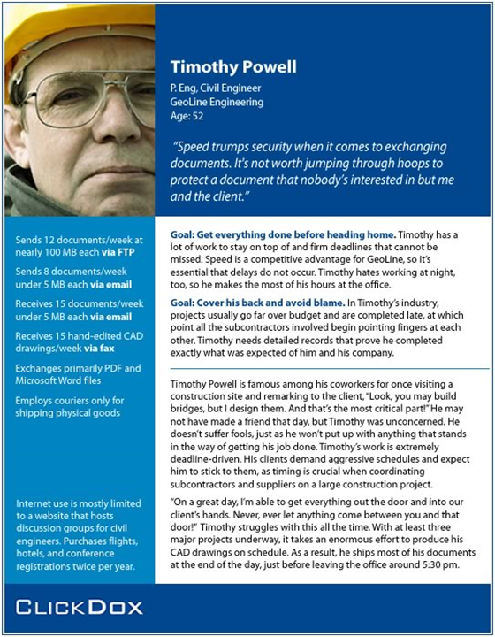
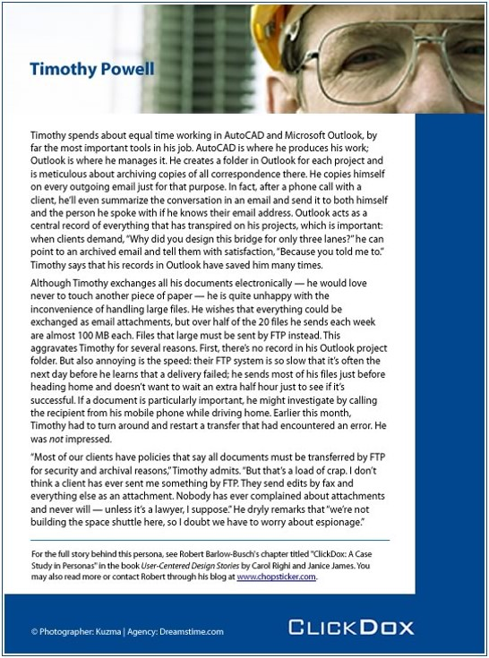
Example

Slide 5
Exercise
Imagine you are building a website for an online movie booking organization with a team of 3 – 4 members. Design a persona for this situation.

Slide 6
Scenario
Think of the scenario as a situation where the persona uses your product.
It’s like a story where you have:
  Main character – Persona
  Goal – what the persona wants to achieve
  Setting – Where the action takes place? What conditions exist at the start of the task?
  Actions/Activities that lead the persona towards their goal
  Outcomes?

Slide 7
Example
Accessing Design Files from a remote server
PACT Analysis
People: Design engineer on a project
Activities: Using the DMS (document management system) to identify released document set for a design part
Context: Remote site work environment, independently managed work activity
Technology: Mobile interface to previous PC-based DMS
Scenario
Tim Powel [Engineer] is on site discussing construction of ‘Bridge D’ ‘Deck’ with contractors. Doesn’t believe that they have all the documentation and needs to check their set of documents against the master set. Uses mobile device to access DMS and authenticates with the system. Selects project ‘Bridge D’ and design part ‘Deck’. Requests the set of released documents to be identified. Works through the identified set of documents checking document codes, release date, and versions with the contractor. Identifies no anomalies with the contractor’s set and completes programme task.

Slide 8
Exercise
Imagine you are creating a solution for an online movie booking website. Create a scenario by referring to your persona within your group.

Slide 9
Functional Requirements
Functional requirements describe what the system should do
You should extract these from the scenarios
The functions you identify as requirements because these help the persona achieve their goal in a scenario.

Slide 10
Example
Scenario
Tim Powel [Engineer] is on site discussing construction of ‘Bridge D’ ‘Deck’ with contractors. Doesn’t believe that they have all the documentation and needs to check their set of documents against the master set. Uses mobile device to access DMS and authenticates with the system. Selects project ‘Bridge D’ and design part ‘Deck’. Requests the set of released documents to be identified. Works through the identified set of documents checking document codes, release date, and versions with the contractor. Identifies no anomalies with the contractor’s set and completes programme task.

Slide 11
Exercise
Extract at least three requirements from the scenarios you created.

Slide 12
Summary
Personas
  describes the main types of users, not a specific user.
Scenarios
  How will the persona use the system to meet their goals?
Requirements
  What do you need in your system so the persona is able to achieve their goals in the scenarios you made up?

